Slide 1







Business Presentation
SEO Navigator: From Audit to Action Summary
Presentation by
Thambidurai Sundaramoorthy

Slide 2
Table of Contents
Project Objective
Company and it’s description
Project Tasks
Initial Audit (SEO)
Keyword Research
On-Page SEO Optimization Audit
Technical SEO
Content Strategy
SEO Strategy and Recommendation

Slide 3


Project Objective
To conduct a comprehensive SEO audit to identify technical and content-related gaps.
To implement keyword research and on-page/off-page strategies to boost rankings.
To increase organic traffic, to improve search engine visibility and to enhance overall online presence.

Slide 4

Company
JustBilling - Simplify your business transactions with our user-friendly POS software
Website URL - https://justbilling.in/
JustBilling is a cloud-based billing and invoicing software designed for businesses of all sizes, including retail stores, restaurants, and service providers. It offers features like GST-compliant invoicing, inventory management, customer loyalty programs, and real-time business insights. With its user-friendly interface and mobile compatibility, JustBilling helps businesses streamline operations and manage sales efficiently.

Slide 5
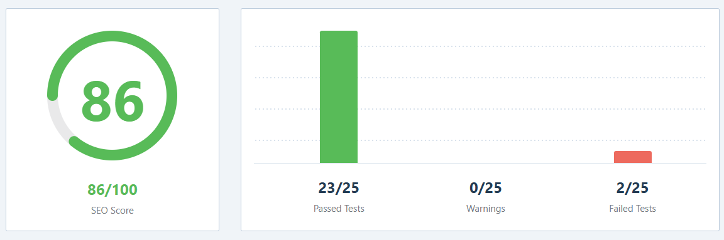
SEO Audit
Audited Site Page - https://justbilling.in/
Online Tool Used: https://rankmath.com/tools/seo-analyzer/

Slide 6



Basic SEO Analysis
Metrics | Tests | Explanations
Keywords |  | Software, billing, justbilling, business, republic, retail, solutions, windows, android, shop.
SEO Description |  | Meta description found with 162 characters. Most search engines will truncate meta description to 160 characters. Simplify your business transactions with our user-friendly - Just Billing is an easy to use and comprehensive GST Invoicing & Billing App for Retail & Restaurant.
H1 Heading |  | One H1 tag was found on your homepage which is good. POS POS POS Software
H2 Headings |  | One or more H2 tags were found on your homepage. JustBilling POS Software, Retail Billing Software, Restaurant Billing Software, POS for Service Business.
Image ALT Attributes |  | All images on your homepage have alt attributes.
Keywords in Title & Description |  | One or more common keywords were found in the title and description of your homepage. Title – software, billing, windows, android Description – billing, business, retail
Links Ratio |  | Homepage has a correct number of internal and external links. 37 internal and 12 external links.
SEO Title |  | The title of the homepage has 61 characters which is good. Just Billing – Best Android, Windows, iOS POS Billing Software
Create a responsive site |  | Your CSS code contains media queries.
Homepage is Reachable |  | Your homepage is reachable.

Slide 7
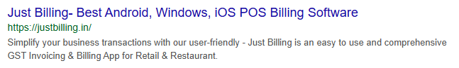
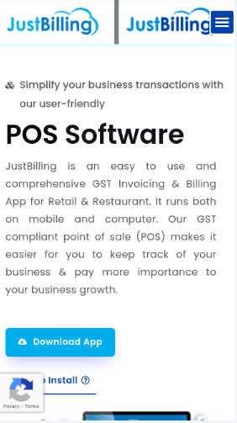
Advances SEO Analysis
Metrics | Tests | Explanations
Search Preview
Mobile Snapshot

Slide 8
Advances SEO Analysis
Metrics | Tests | Explanations
Canonical Tag |  | Your homepage is using the canonical link tag. https://justbilling.in/
Noindex Meta |  | Homepage contains index meta tag or header.
WWW Canonicalization |  | Both www and non-www versions of your URL are redirected to the same site.
OpenGraph Meta |  | Opengraph meta tags have been found.
Robots.txt |  | Your site has a robots.txt file which includes one or more Disallow: directives. Make sure that you only block parts you don't want to be indexed.
Schema Meta Data |  | Schema.org data has been found on your homepage.
Keep your content fresh |  | Your content is fresh. Last updated on 2025-03-21 (3 days ago) via XML Sitemap.
Sitemaps |  | Your site has one or more sitemaps.

Slide 9
Performance & Security
Metrics | Tests | Explanations
Image Headers Expire |  | No local images found.
Minify CSS |  | All CSS files appear to be minified.
Minify Javascript |  | All Javascript files appear to be minified.
Page Objects |  | Homepage makes 2 requests. Total – 2, images, 1, javascript – 0, stylesheets – 1.
Page Size |  | The size of the HTML document is 85 Kb, over the average of 33 Kb and our recommendation of 50 Kb.
Response Time |  | Response time is under 0.2 seconds which is great.
Metrics | Tests | Explanations
Visible Plugins |  | 1 plugins from your website are publicly visible. Litespeed Cache
Theme Visibility |  | Theme is not publicly visible. No one can tell which theme you are using.
Directory Listing |  | Directory Listing seems to be disabled on your server.
Secure Connection |  | Your site is using a secure transfer protocol (https).

Slide 10
SWOT Analysis
Strengths
Mobile Friendly - The site optimizes itself for different devices for smooth user experience.
HTTPs Security - It uses SSL encryption which can be trustable and a ranking factor.
Navigations & CTAs - Navigations are easy to navigate and have strong call to action buttons for engagement.
Content Relevant - It mainly focuses on billing software solutions aligns with user search intent.
Weaknesses
Page Speed Issues – Need optimization for faster loading to improve user experience and ranking.
Backlink Profile Limits – Needs stronger backlinks from authoritative sources to boost domain authority.
Meta Tags & Keyword Optimization – Title, descriptions and content could be better optimized for SEO.
Content Depth & Blog Strategy – More active blog with regular updates could improve organic traffic.

Slide 11
SWOT Analysis
Opportunities
Local SEO Optimization – Google My Business optimization and adding local keywords can improve visibility.
Technical SEO Improvement – Enhancing core web vitals and fixing crawl issues can boost rankings.
Content Marketing – Publishing high-quality, keyword-rich blogs can drive organic traffic.
Social Media & Video Marketing – Leveraging LinkedIn, YouTube and other platforms can increase brand authority and backlinks.
Threats
Competitor Growth – Competing billing software websites with stronger SEO can outrank JustBilling.in.
Google Algorithm Updates – Changes in search algorithms could impact rankings if not adapted.
Low Engagement Rates – It could consider poor user experience to search engine If users bounce off quickly.
Paid Ad Dependence – Over-reliance on ads instead of organic traffic can increase marketing costs.

Slide 12
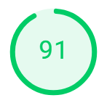
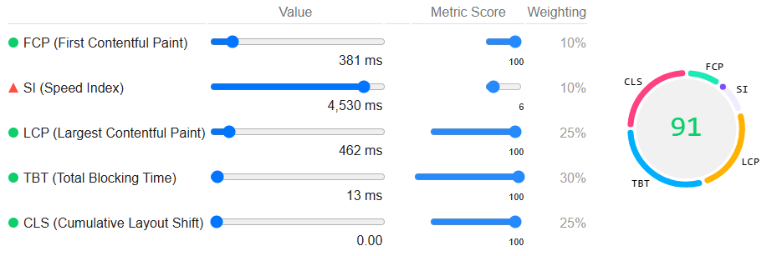
Technical SEO Analysis
Online Tool Used: https://pagespeed.web.dev/
Performance Analysis for Desktop

Slide 13
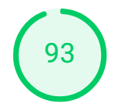
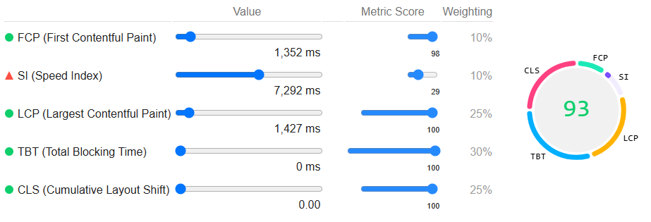
Technical SEO Analysis
Performance Analysis for Mobile

Slide 14
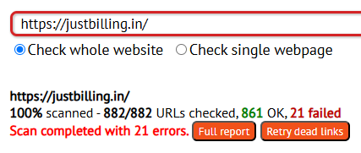
Broken Links in the Website
Online Tool Used: https://www.deadlinkchecker.com/
Status | Total Numbers
Total Links | 882
Working Links | 861
Broken Links | 21
Backlinks in the Website
Online Tool Used: https://ahrefs.com/backlink-checker
Status | Total Numbers
Domain Rating | 12
Total links from other websites | 3.3K
Total unique links from other websites | 238

Slide 15
Keywords Research
Online Tool Used: https://backlinko.com/tools/keyword
Retail Billing Software
Keyword Categories | Keywords
Commercial | billing software for retail shop best billing software for retail shop best retail billing software
Navigational | retail billing software retail store billing software gst billing software for retail retail shop billing software billing software for retail store
Transactional | billing software for retail shop free download billing software for retail shop india

Slide 16
Keywords Research
Restaurant Billing Software
Keyword Categories | Keywords
Commercial | best billing software for restaurant best restaurant billing software best software for restaurant billing
Navigational | restaurant billing software billing software for restaurant bar and restaurant billing software pos billing software for restaurant
Transactional | restaurant billing software free download restaurant billing software price free restaurant billing software
Keyword Categories | Keywords
Commercial | best billing software for restaurant best restaurant billing software best software for restaurant billing
Navigational | restaurant billing software billing software for restaurant bar and restaurant billing software pos billing software for restaurant
Transactional | restaurant billing software free download restaurant billing software price free restaurant billing software

Slide 17
Competitor Keywords Research
Competitors (Organic)
Tally Solutions Vyapar myBillBook
Keyword Categories | Keywords
Commercial | best billing software for small businesses in India Top invoicing software with inventory management
Navigational | billing software gst billing software Invoicing software
Transactional | Free gst billing software download

Slide 18
Competitor Strategies
Competitors offer comprehensive business management with features like GST billing, invoicing, inventory management and e-way billing.
Emphasizing user-friendly interface for small businesses to diverse business needs.
They publish blogs, tutorials, case studies and active presence on social media platforms to engage and educate the potential users and to improve SEO rankings.
Collaborates with industry association and participates in events to increase brand visibility.
They offer extensive customer support, training programs, certification courses and FAQ to assist users.

Slide 19
On-Page SEO Optimization Audit
Online Tools Used: SEO Meta Extension and SEO Analyzer
SEO Analyzer - https://rankmath.com/tools/seo-analyzer/
Audited Web Pages
Retail Billing Software – https://justbilling.in/retail-billing-software/
Restaurant Billing Software – https://justbilling.in/restaurant-billing-software/
On-Page SEO Optimization Audit Includes
Title Tags
Meta Descriptions
Keywords Usage
Internal/External linking
Image Optimization

Slide 20
Retail Billing Software On-Page SEO Audit
Retail Billing Software – https://justbilling.in/retail-billing-software/
Metrics | Tests | Explanations
Keywords |  | No keywords found on this particular page.
SEO Description |  | Meta description found with 173 characters. Most search engines will truncate meta description to 160 characters. Just Billing Retail Invoicing & Billing App provides a faster billing experience for retailers & Business owners. All-in-one tools for smooth Retail operations for invoicing
H1 Heading |  | No H1 tag found on this particular page. For the best SEO results there should be exactly one H1 tag on each page.
H2 Headings |  | One or more H2 tags were found on your homepage. Retail Billing Software, Enhance Customer Experience: Retail Billing Software, Reliable Retail Billing Solutions, Serve Your Drinks with Efficiency and Ease, Professional Services Need Professional Solutions
Image ALT Attributes |  | Total of 42 images found where as 1 image didn’t have an alt attribute and 40 images didn’t have a title.
Keywords in Title & Description |  | No keywords found for Title & Description for this particular page.
Links Ratio |  | 332 total links were found on this particular page. 63 were unique links where as out of which 45 unique links are internal and 18 unique links were external.
SEO Title |  | The title of the homepage has 71 characters which is not within the acceptable range. Just Billing Retail Invoicing & Billing Software: Simplify transactions

Slide 21
Restaurant Billing Software On-Page SEO Audit
Retail Billing Software – https://justbilling.in/retail-billing-software/
Metrics | Tests | Explanations
Keywords |  | No keywords found on this particular page.
SEO Description |  | Meta description found with 159 characters which is good. Just Billing Restaurant POS software to manage your restaurant billing, inventory. Are you planning to start one, take a look at how Just Billing can help you.
H1 Heading |  | No H1 tag found on this particular page. For the best SEO results there should be exactly one H1 tag on each page.
H2 Headings |  | One or more H2 tags were found on your homepage. Restaurant Billing Software, Streamline your Restaurant's Operations, Upgrade to JustBilling POS, Serve Your Drinks with Efficiency and Ease, Professional Services Need Professional Solutions
Image ALT Attributes |  | Total of 39 images found where as 1 image didn’t have an alt attribute and 37 images didn’t have a title.
Keywords in Title & Description |  | No keywords found for Title & Description for this particular page.
Links Ratio |  | 330 total links were found on this particular page. 63 were unique links where as out of which 45 unique links are internal and 18 unique links were external.
SEO Title |  | The title of the homepage has 55 characters which is good. Just Billing Restaurant POS Billing & Management System

Slide 22
Technical SEO
Audited Web Pages
Home Page - https://justbilling.in/
Retail Billing Software – https://justbilling.in/retail-billing-software/
Restaurant Billing Software – https://justbilling.in/restaurant-billing-software/
Technical SEO Audit Includes
Page Speed
Mobile Friendliness
Broken Links
Online Tools Used
Page Speed Insights - https://pagespeed.web.dev/
Responsive Design Checker - https://responsivedesignchecker.com/
Deadline Checker - https://www.deadlinkchecker.com/

Slide 23
Home Page – Page Speed Analysis
Performance Analysis for Desktop

Slide 24
Home Page – Page Speed Analysis
Performance Analysis for Mobile

Slide 25

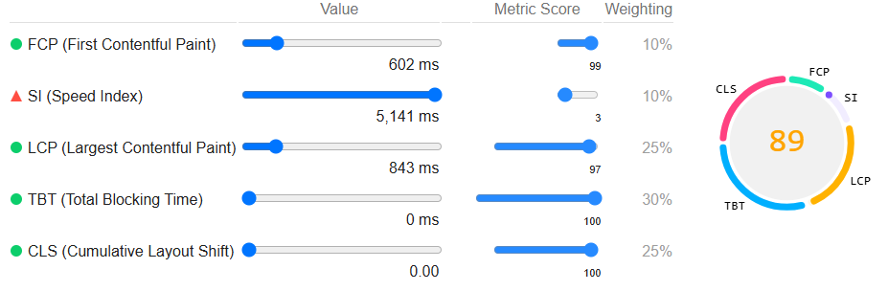
Retail Billing Software – Page Speed Analysis
Performance Analysis for Desktop

Slide 26

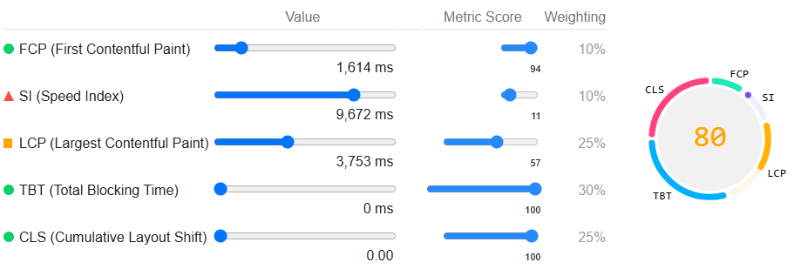
Retail Billing Software – Page Speed Analysis
Performance Analysis for Mobile

Slide 27

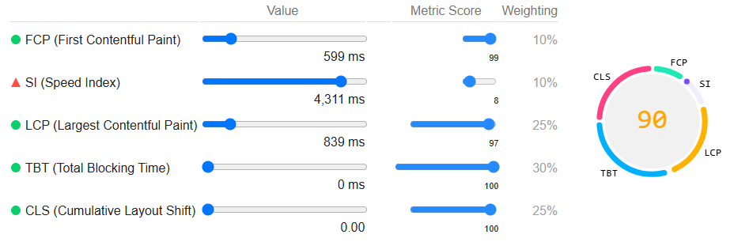
Restaurant Billing Software – Page Speed Analysis
Performance Analysis for Desktop

Slide 28

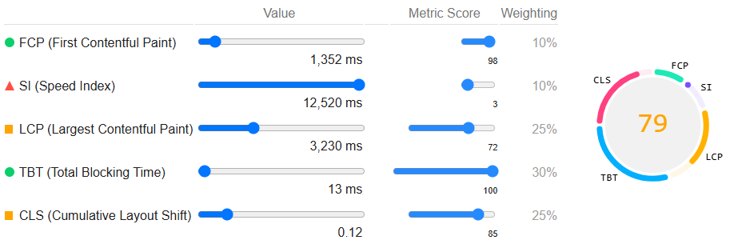
Restaurant Billing Software – Page Speed Analysis
Performance Analysis for Mobile

Slide 29
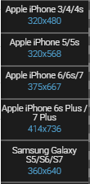
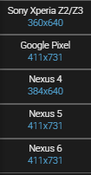
Mobile Friendliness

Slide 30
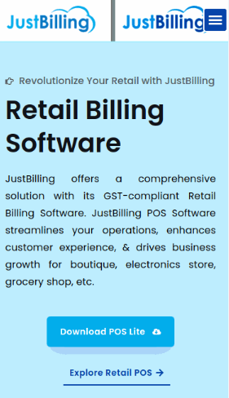
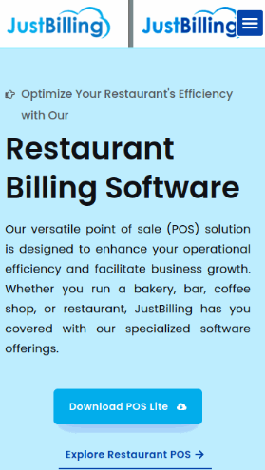
Mobile Snapshots
Retail Billing Software
Restaurant Billing Software
Home Page

Slide 31
Broken Links
Site Web Pages | Total Links in the Web Page | Broken Links in the Web Page
Home Web Page | 76 | 3
Retail Billing Software | 76 | 2
Restaurant Billing Software | 76 | 2
Site Web Pages | Broken Links
Home Web Page | https://www.linkedin.com/company/just-billing-official/ https://www.instagram.com/accounts/login/?next=https%3A%2F%2Fwww.instagram.com%2Fjustbilling%2F&is_from_rle https://justbilling.in/xmlrpc.php
Retail Billing Software | https://www.linkedin.com/company/just-billing-official/ https://www.instagram.com/accounts/login/?next=https%3A%2F%2Fwww.instagram.com%2Fjustbilling%2F&is_from_rle
Restaurant Billing Software | https://www.linkedin.com/company/just-billing-official/ https://www.instagram.com/accounts/login/?next=https%3A%2F%2Fwww.instagram.com%2Fjustbilling%2F&is_from_rle

Slide 32
Technical SEO Issues
Site Web Pages | Page Speed for Desktop | Page Speed for Mobile | Mobile Friendliness | Broken Links
Home Web Page | Speed Index(SI) exceeds the threshold value. | Speed Index(SI) exceeds the threshold value. | No issues found. Site scales itself automatically depending on the device screen size and it’s mobile friendly site. | 3 links are broken
Retail Billing Software | Speed Index (SI) exceeds the threshold value. | Speed Index (SI) and Largest Contentful Paint (LCP) exceeds the threshold values. | No issues found. Site scales itself automatically depending on the device screen size and it’s mobile friendly site. | 2 links are broken
Restaurant Billing Software | Speed Index (SI) exceeds the threshold value. | Speed Index (SI), Largest Contentful Paint (LCP) and Cumulative Layout Shift (CLS) exceeds the threshold values. | No issues found. Site scales itself automatically depending on the device screen size and it’s mobile friendly site. | 2 links are broken

Slide 33
Best Practices to improve Site Performance
Compress Images
Compress images using tools TinyPNG and WebP format.
Use responsive images with correct dimensions.
Implement slow loading images to load only when needed.
Enable Browser Caching
Store static assets like CSS, JS and images in the browser.
Set cache expiration for frequently used files.
Use “.htaccess” or serve settings to enable caching.
Minimize CSS and JavaScript Files
Reduce the number of CSS, JavaScript and image files.
Use CSS sprites for icons and small images
Combine multiple CSS and JS files into fewer files.
Use a Content Delivery Network (CDN)
Deliver site content from the nearest server to the user.
Reduce server load and improve the global speed.
Use popular CDNs like Cloudflare, AWS CloudFront.
Improve Server Response Time
Upgrade to faster hosting (VPS or dedicated servers).
Minify and defer CSS and JavaScript files.
Optimize database queries and enable GZIP compression.

Slide 34
Content Strategy
Blog Topics | Content Format | Related Keyword | User Intent Category
"Best Retail Billing Software: Features, Benefits & Top Picks for 2024" | Listicles (List-Based Articles) | best retail billing software | Commercial
"GST Billing Software for Retail: Features, Benefits & How to Choose the Best One" | How-To Guides (Step-by-Step Tutorials) | gst billing software for retail | Navigational
"Billing Software for Retail Shops in India: Features, Benefits & Top Picks" | Infographics & Visual Content Blogs | billing software for retail shop in India | Transactional
"Best Software for Restaurant Billing: Features, Benefits & Top Solutions" | Infographics & Visual Content Blogs | best software for restaurant billing | Commercial
"POS Billing Software for Restaurants: Features, Benefits & Best Solutions in 2024" | Listicles (List-Based Articles) | pos billing software for restaurant | Navigational
"Restaurant Billing Software Price: Features vs. Cost – What’s the Best Value for Your Business?" | Industry Trends & News Updates | restaurant billing software price | Transactional

Slide 35
SEO Strategy and Recommendations
The Speed Index (SI) exceeds its range in all the analysis which should be within the range to have the contents quickly visible on the page.
Improve the Page Speed loading times by compressing images, leveraging browser caching, and minimizing code.
The SEO Title character length should be within the range between 40 to 65 by relating to the keywords research.
The Meta Description should accurately reflect the content and the character length should be within the range between 120 to 160.
Use Header Tags (H1,H2,H3) to structure content hierarchically, making it easier for search engines to understand the page's main topics.
Should Incorporate descriptive Alt Text for all images to improve accessibility and provide additional context to search engines.
Create informative and engaging content that addresses the specific needs of your target audience through different format Blog Posts by offering step-by-step guides on utilizing various features of JustBilling software effectively.

Slide 36
SEO Strategy and Recommendations
The Keyword Research should focus on the character length by creating short-tail & long-tail keywords. Should identify the terms and specific phrases that our potential customers search for.
The Broken Links should be identified on all the web pages in the website to replace it with the correct reachable links.
Acquire authoritative Backlinks to boost domain authority and search rankings by collaborating with complementary businesses to create joint content or promotions that include mutual linking. Also, contribute articles to reputable industry blogs and include links back to your site through Guest Blogging.
Leverage local SEO for specific geographic regions by optimizing for local search through Google My Business (GMB) with accurate contact information and to incorporate location-based keywords.
Use Google analytics to track website traffic & conversions and monitor SEO rankings using tools like Ahrefs or SEMrush.
Measure Social Media engagement with insights from Facebook, Instagram & YouTube and track Google My Business inquiries and reviews.

Slide 37





Thank You
Thambidurai Sundaramoorthy
stdurai95@gmail.com

